Slide 1

CULTURE VS FUNCTION
A Comparison among Capitals and Financial Centers of America and ChinA

Slide 2
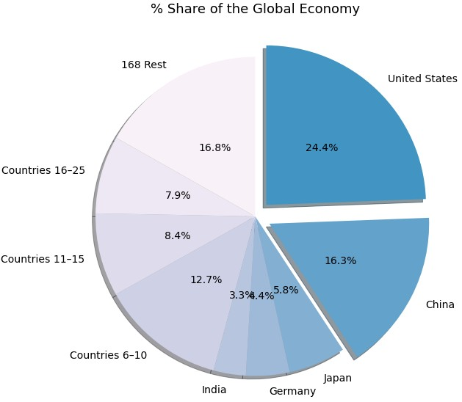
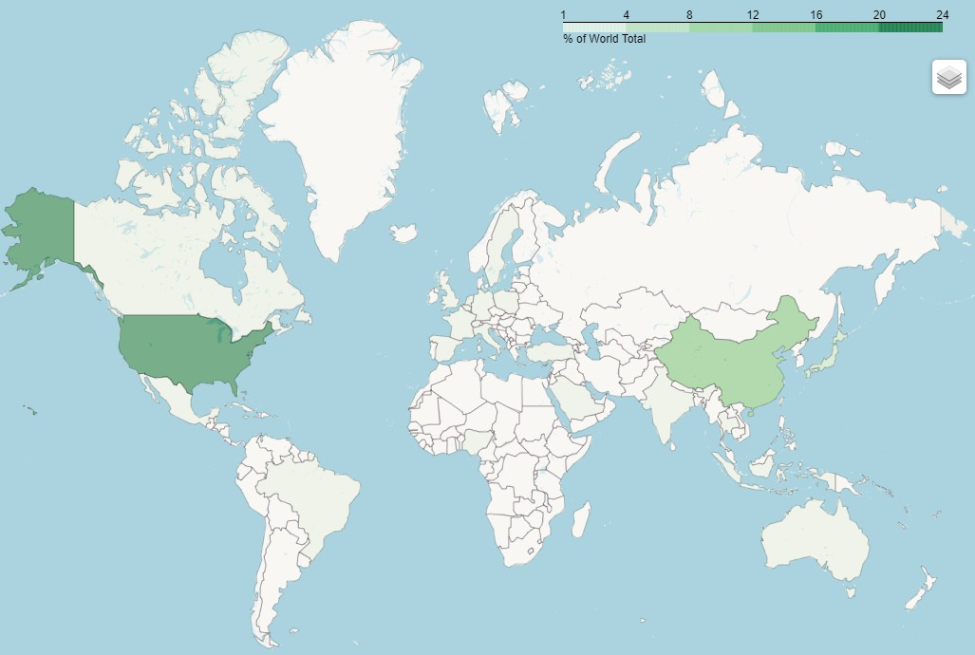
INTRODUCTION
US and China are two of the largest economies in the world: US - 24.4 %, China - 16.3 %
Investor could be of great interest to the both great markets
It is meaningful to take a glance to the both countries via their representative cities

Slide 3
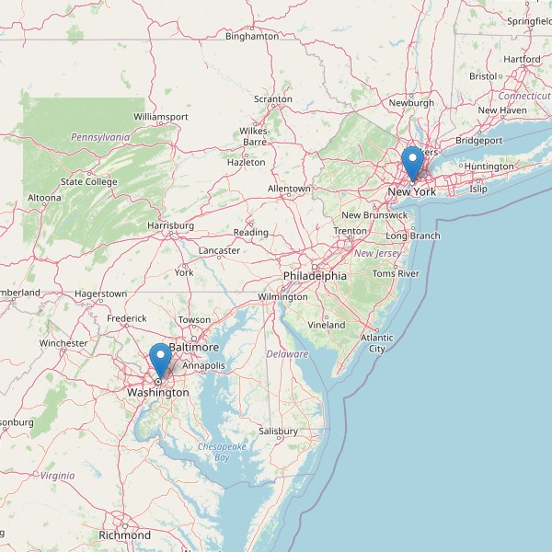
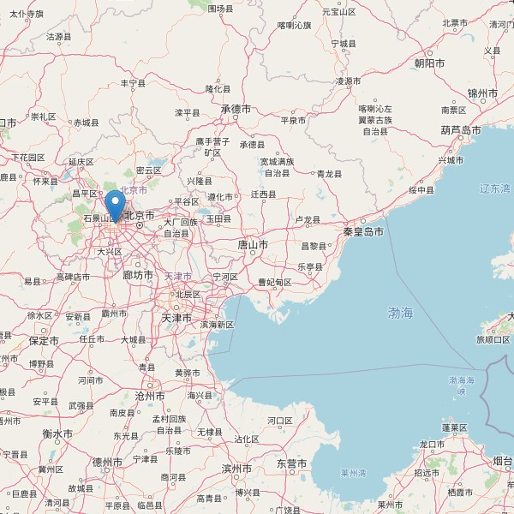
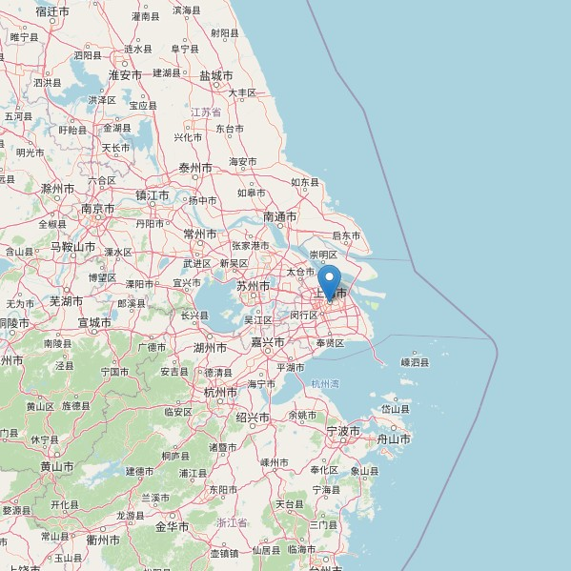
INTRODUCTION
Washington DC & Manhattan
Beijing
Shanghai
The capital cities of US and China are Washington DC and Beijing. Both are at the location close to ocean.
The financial centers of both countries are Manhattan and Shanghai, which also present as important ports.
These coincidences make it intriguing to compare both countries through the four cities.

Slide 4
DATA AND METHODOLOGY
Manhattan
Downtown
State of Liberty
Museum
Upper West Side
Central Park
City
Neighborhood
Venue
Venue
Category
Analysis
Landmark
Neighborhood feature
Park
City property
1. Obtain neighborhood list of each city, then request venues information through Foursquare API
2. Use the frequency of venues categories in a neighborhood to generate the feature of the neighborhood
3. Conduct city analysis using the neighborhood features

Slide 5
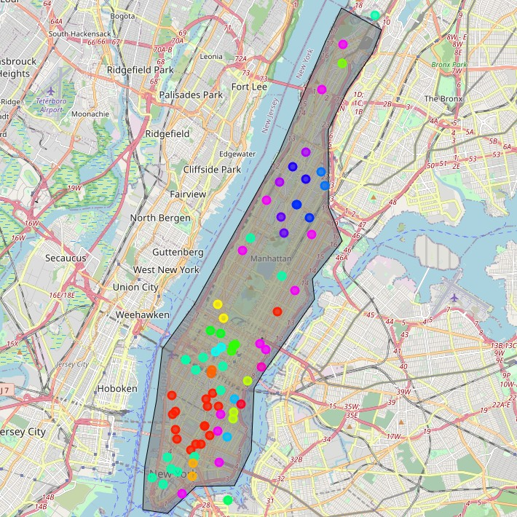
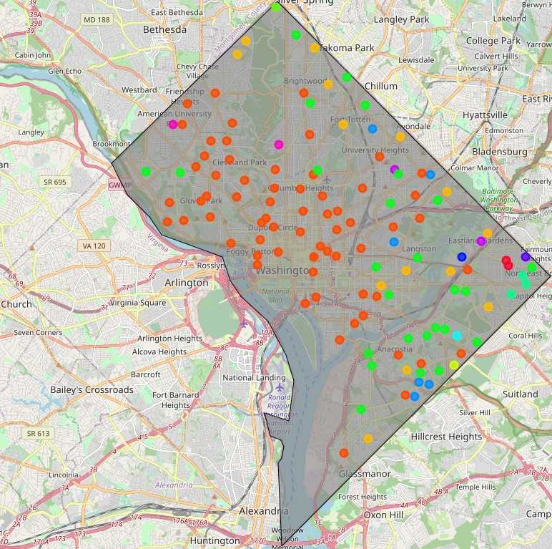
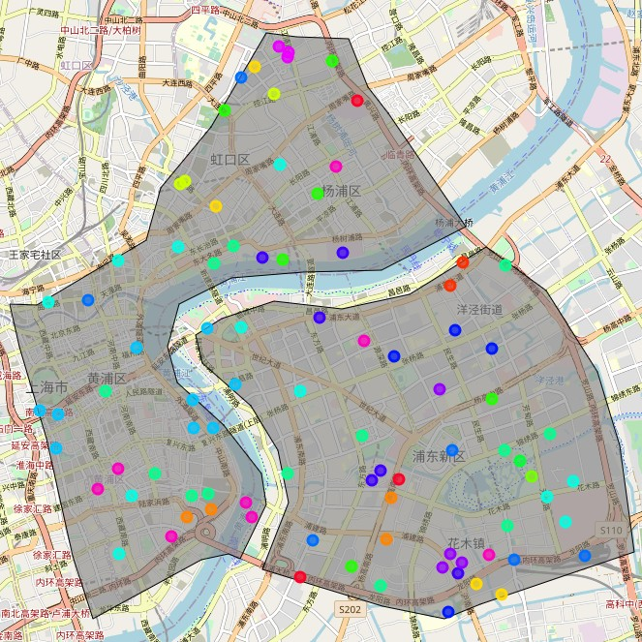
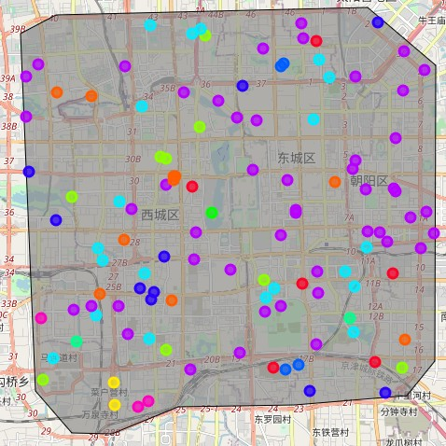
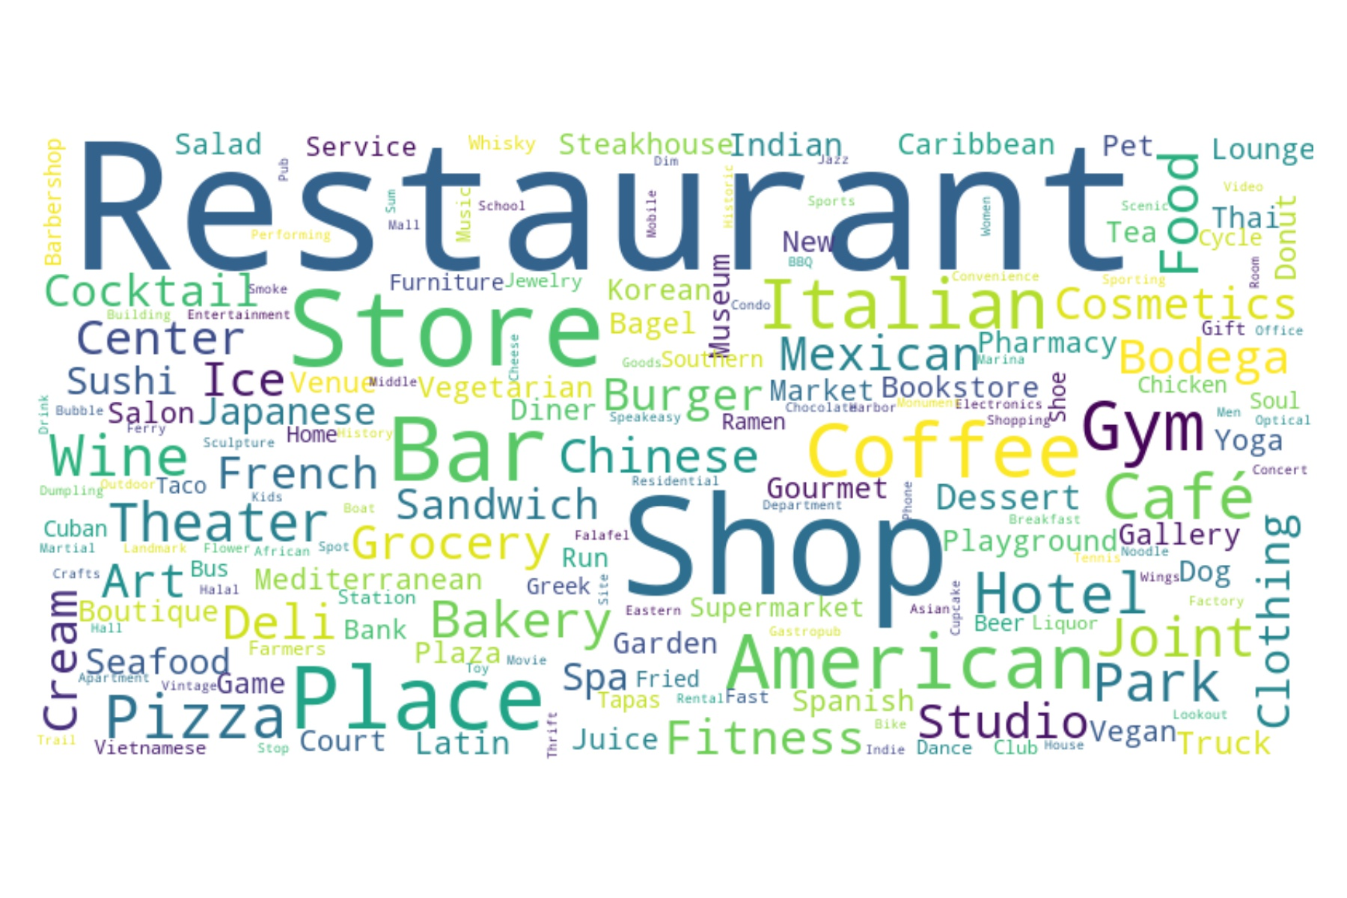
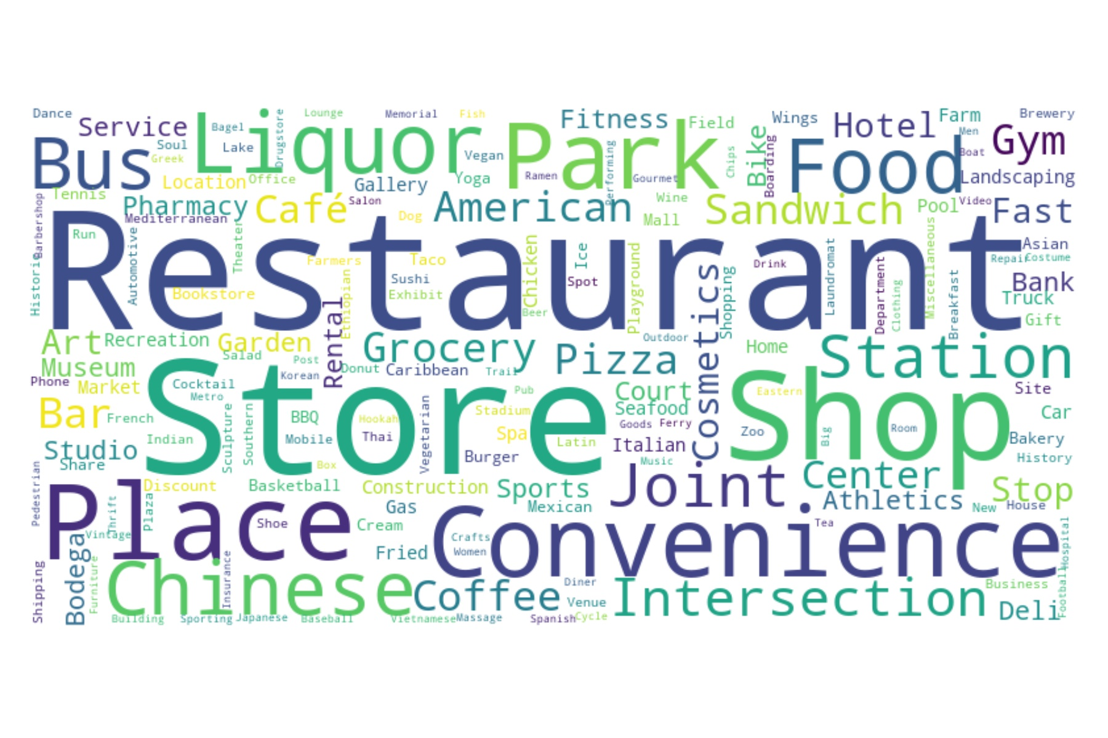
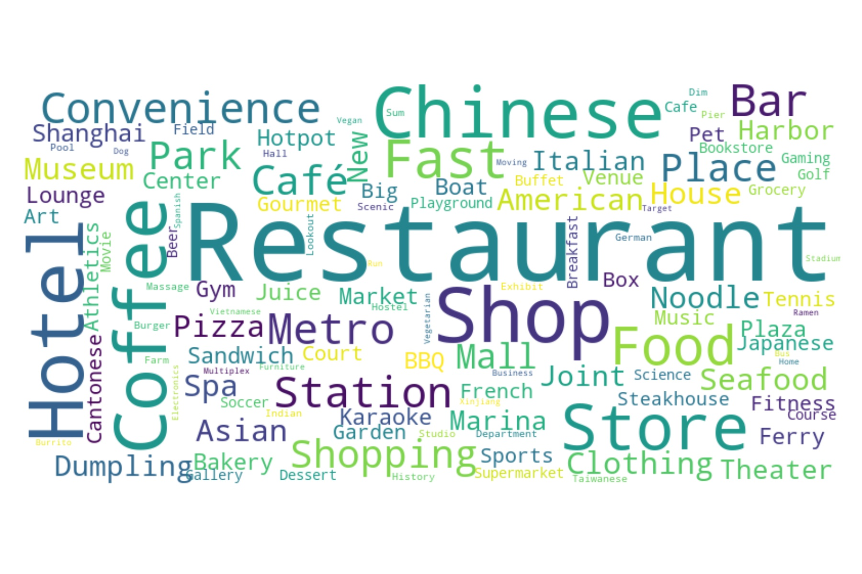
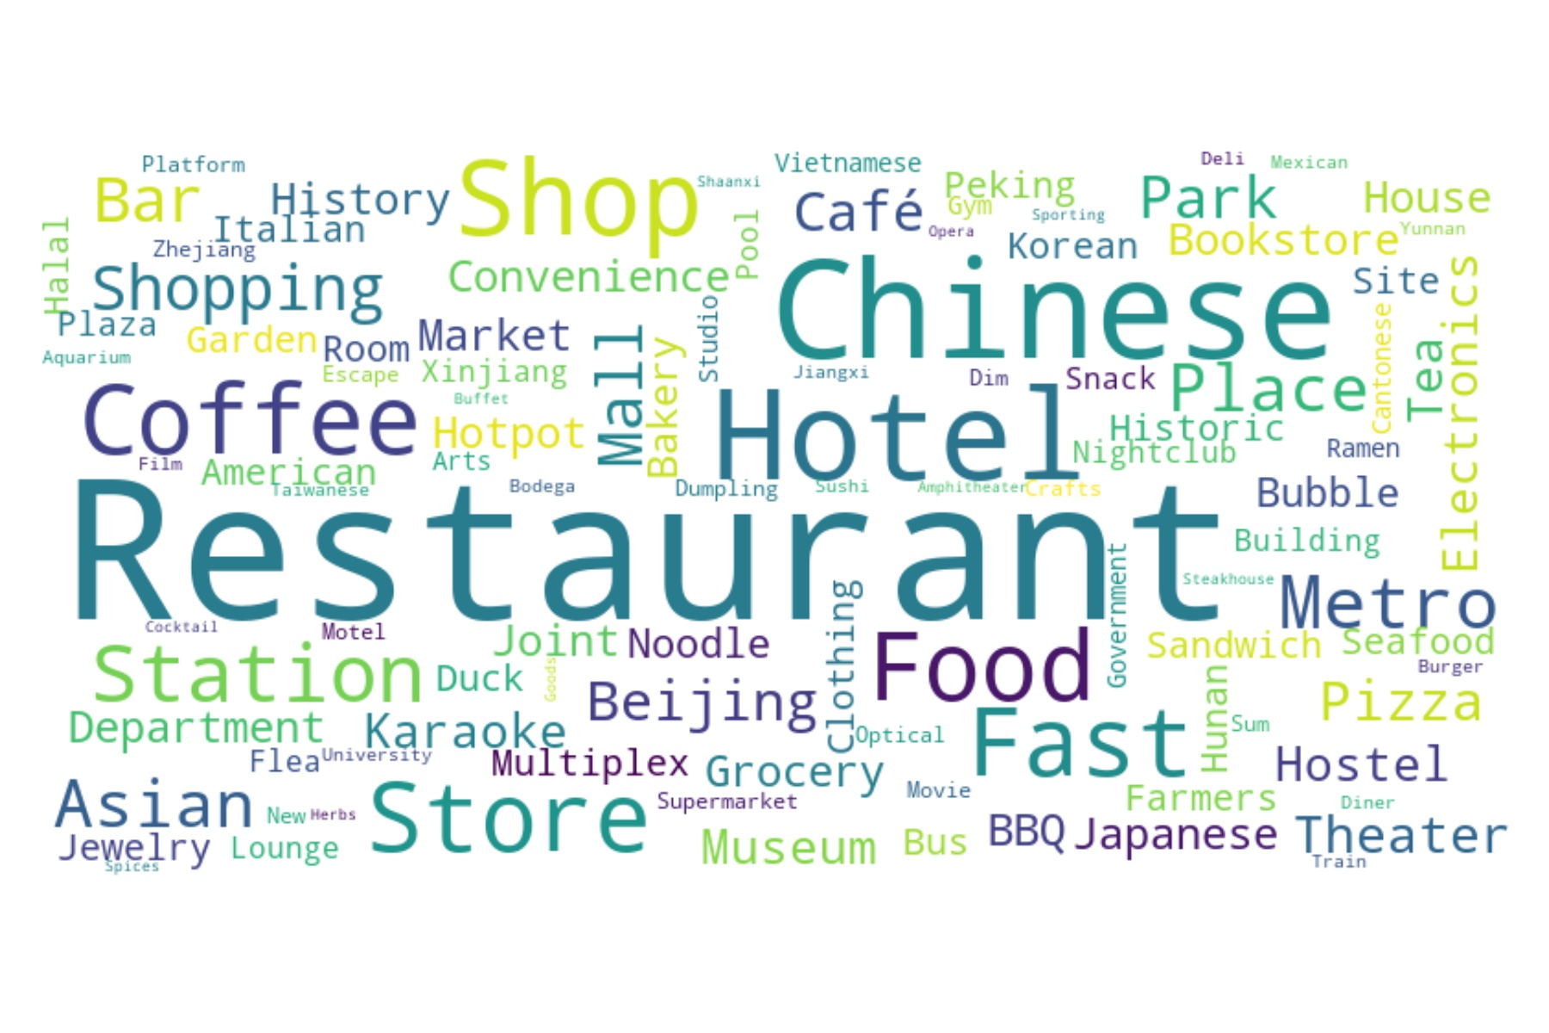
Result & Discussion
same cluster neighborhoods aggregate
neighborhoods clusters randomly distributed
Restaurant is the most needed venues in all cities. American and Italian restaurants are favorable in Manhattan, while Chinese restaurant are popular in the rest three cities.
Stores and shops are also highly needed in all cities.
Coffee shops are popular in Manhattan, Beijing and Shanghai, while Washington DC has lots of liquor stores.
Hotels and metro stations are highly needed in Chinese cities.

Slide 6
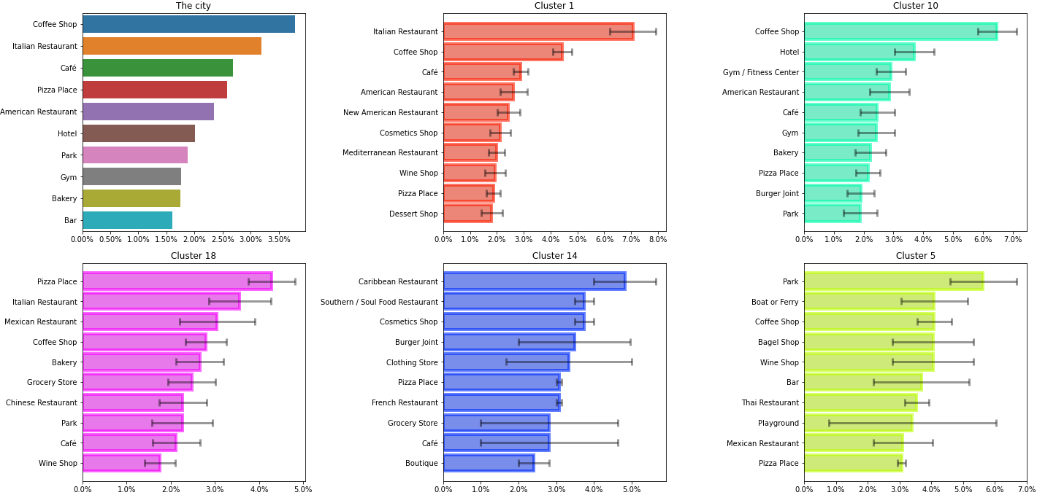
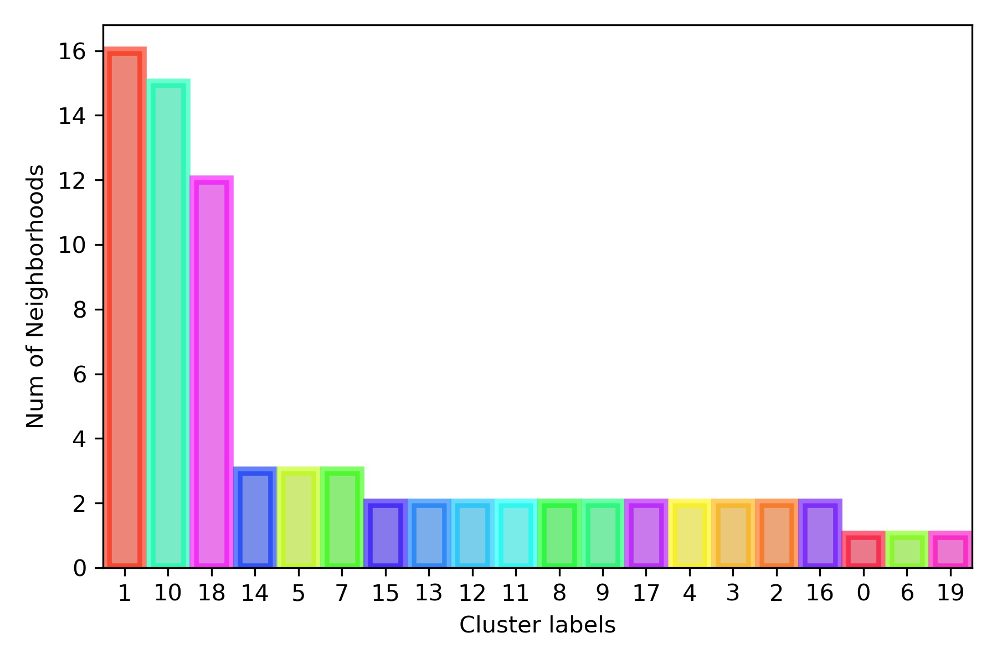
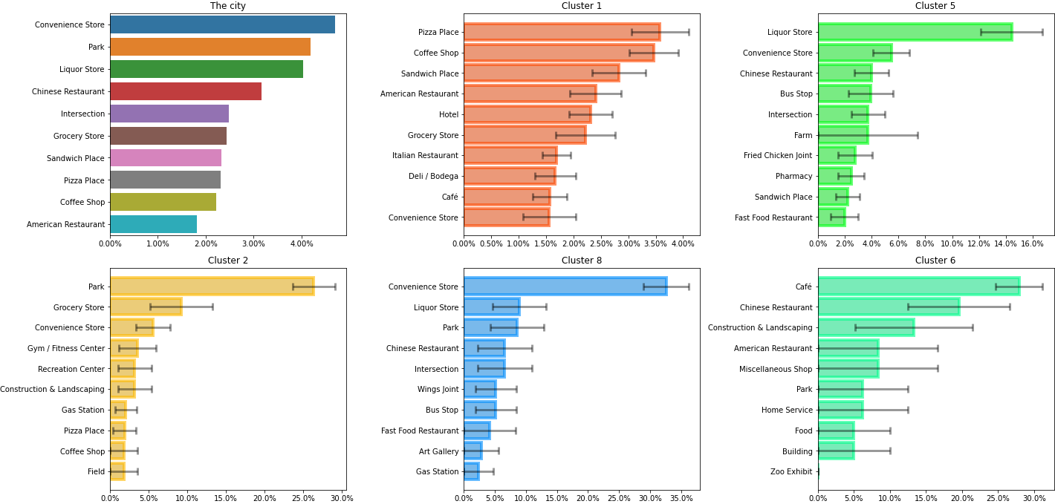
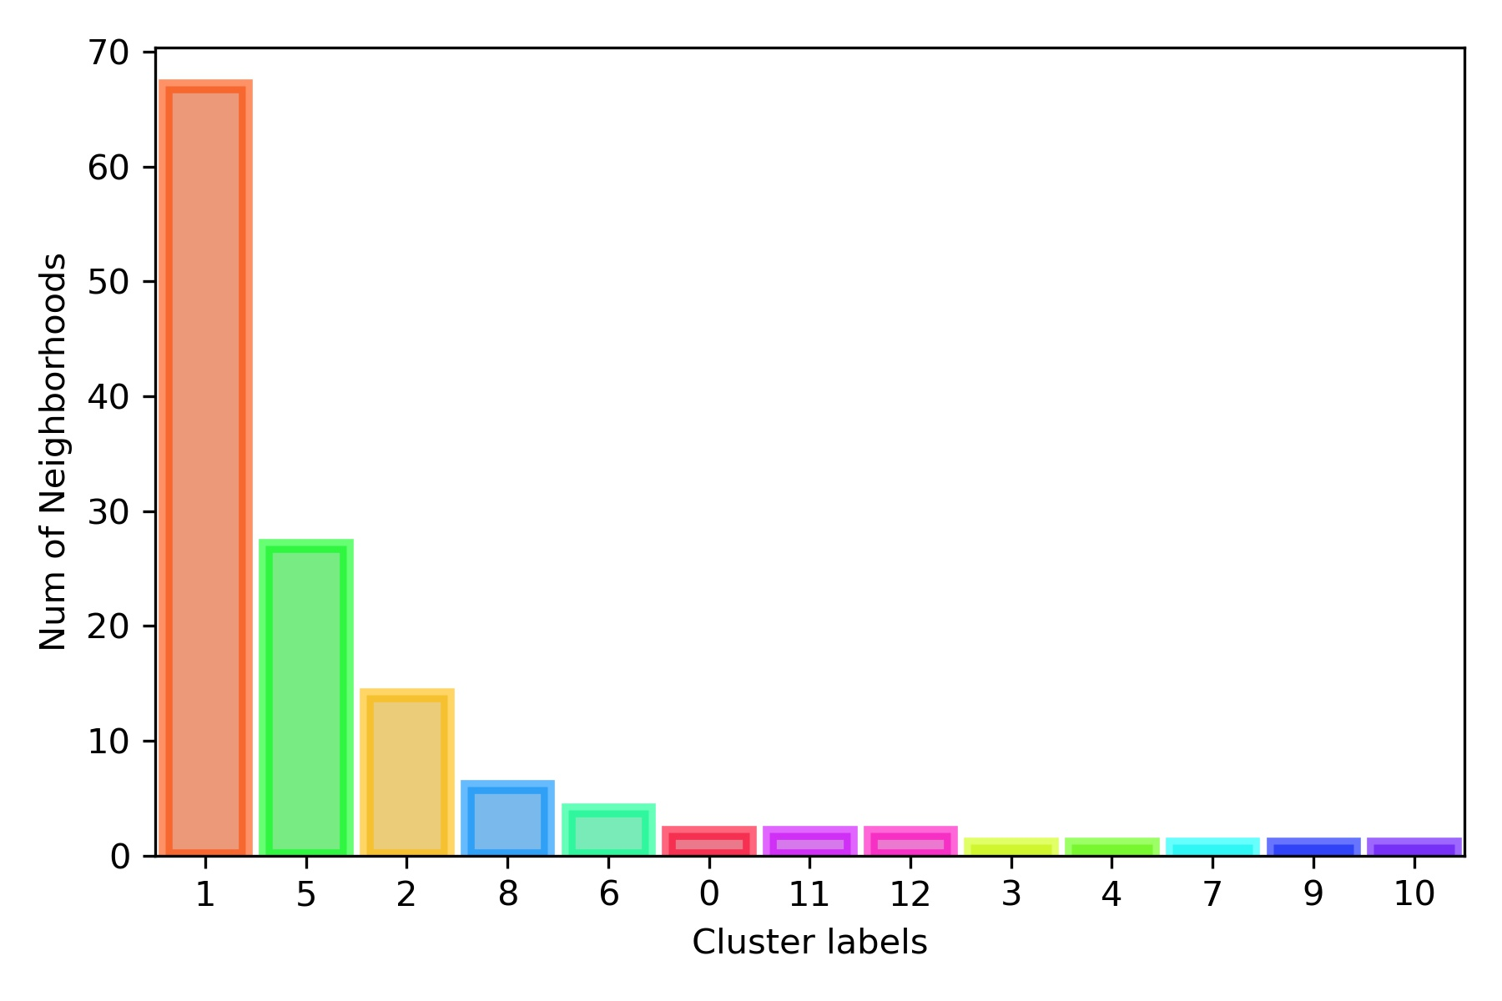
Result & Discussion
Manhattan
Washington DC
As seen before, the coffee shop, Italian and American food are abundant in Manhattan.
Gyms and bars are of high requirement in Manhattan.
Though American restaurants are also the top ten venues, the Chinese restaurants are more popular in DC.
In DC, the cluster 5 contains a high percentage of liquor store, and the neighborhoods in this cluster mainly distributed in suburban regions.
6

Slide 7
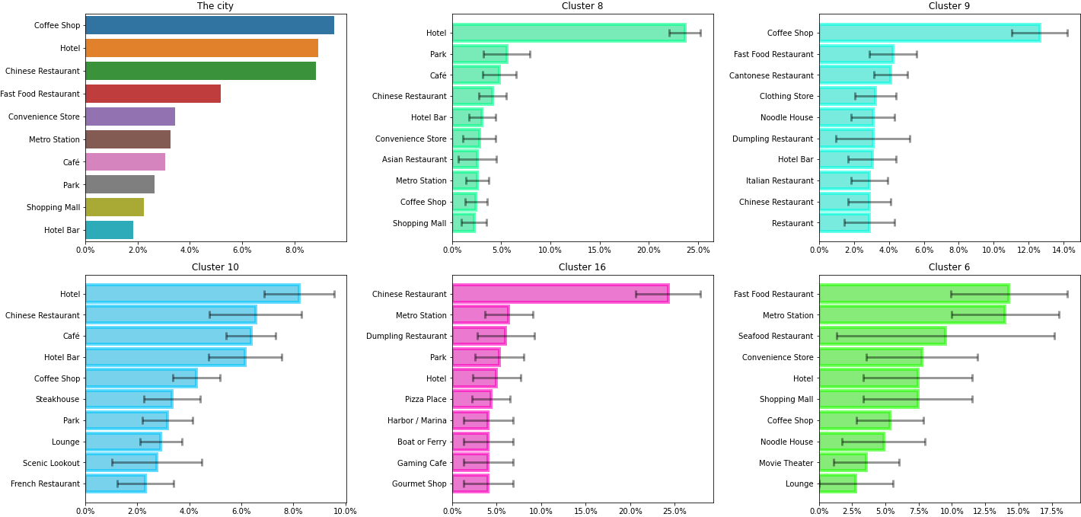
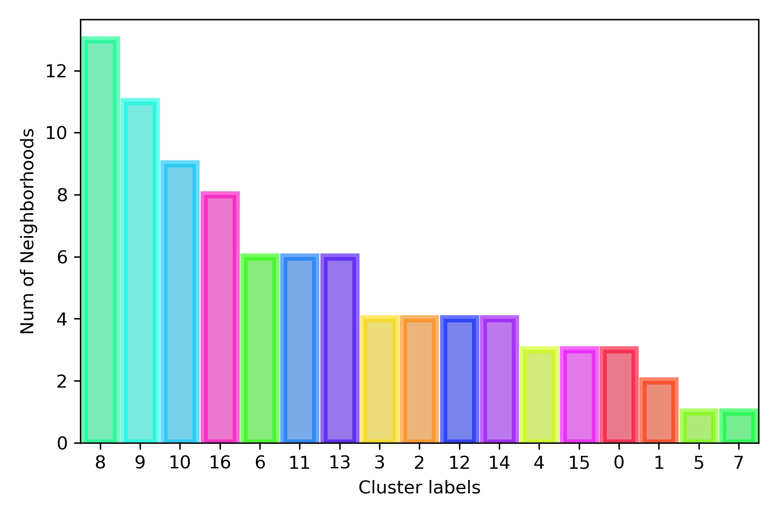
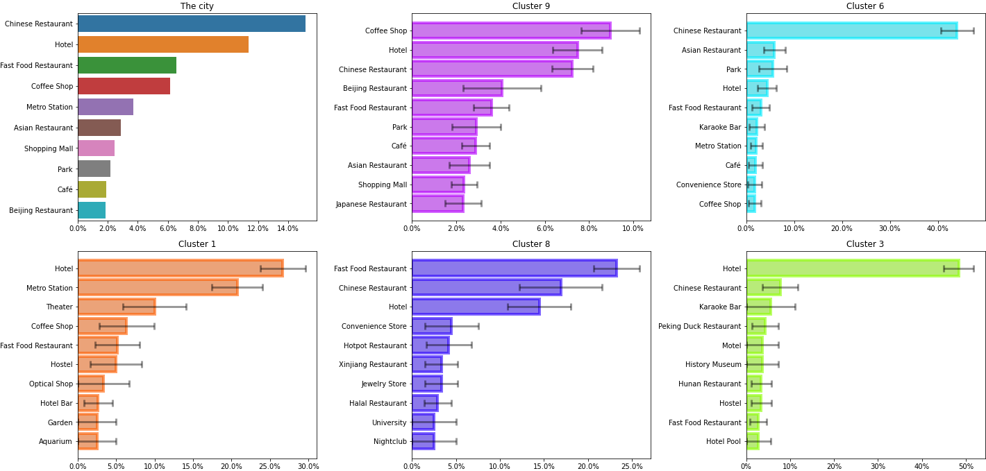
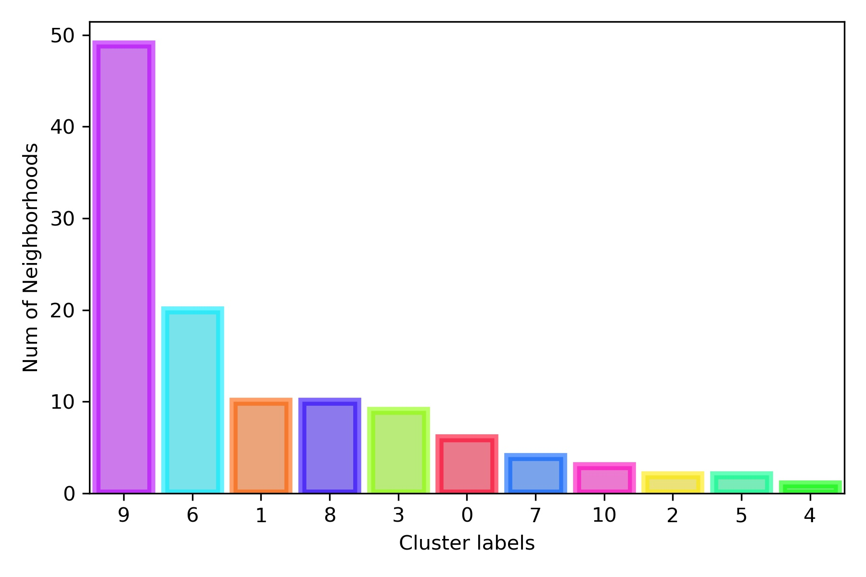
Result & Discussion
Shanghai
Beijing
The Chinese cities show obviously high requirement of Chinese restaurants.
Distinctly, there are lots of hotels, metro stations and shopping malls in Chinese cities.
Though China has a long history of tea, coffee shops are very popular in the both modern Chinese cities, even for Beijing which has a history of over 600 years.
The distribution of venues does not show obvious pattern, instead it is random in Chinese cities.
7

Slide 8
Result & Discussion
NIGHTLIFE
Beer Bar
Bar
Cocktail Bar
Jazz Club
Rock Club
Clustering result
Manhattan Clusters
DC Clusters
Shanghai Clusters
Beijing Clusters
Complete data
Manhattan Data
DC Data
Shanghai Data
Beijing Data
SPORTS FIELD
Soccer Field
Skating Rink
Playground
Tennis Court
Volleyball Court
In considering of the different categorization of venues in different countries in Foursquare data, we combine some similar venue categories to get a picture at a macro level.
……
8

Slide 9
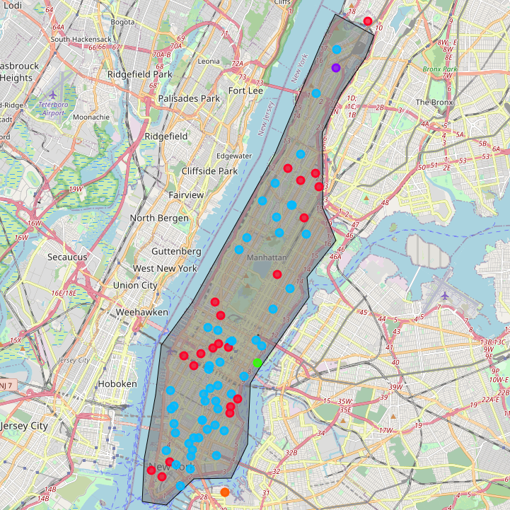
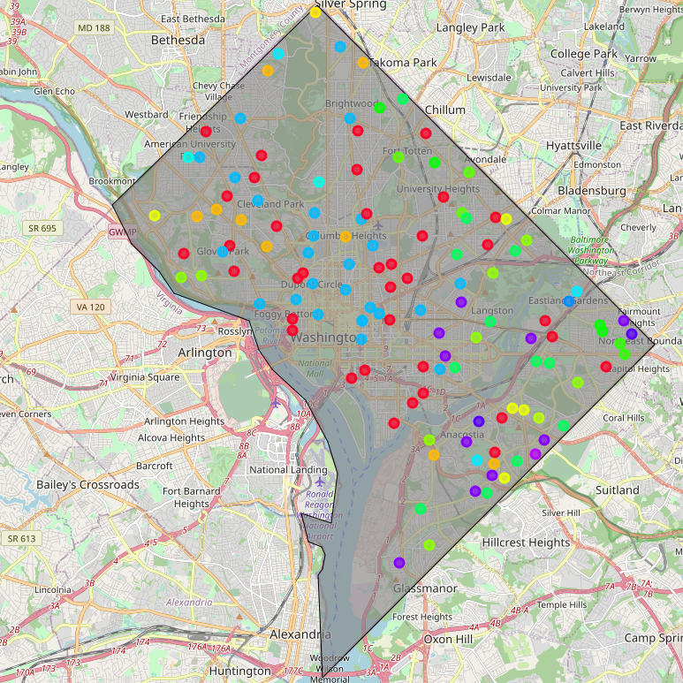
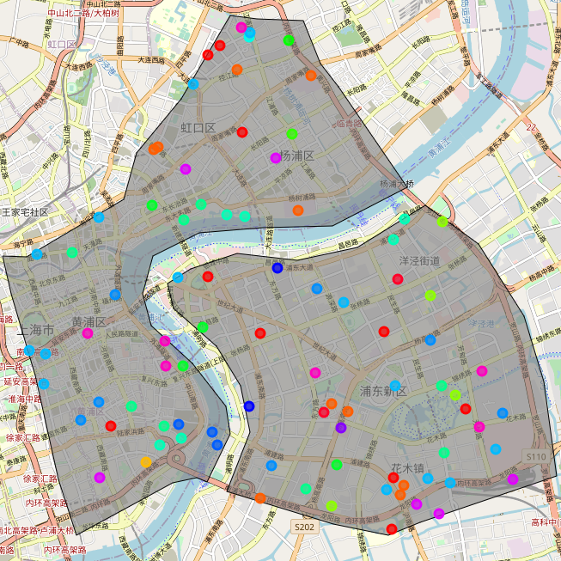
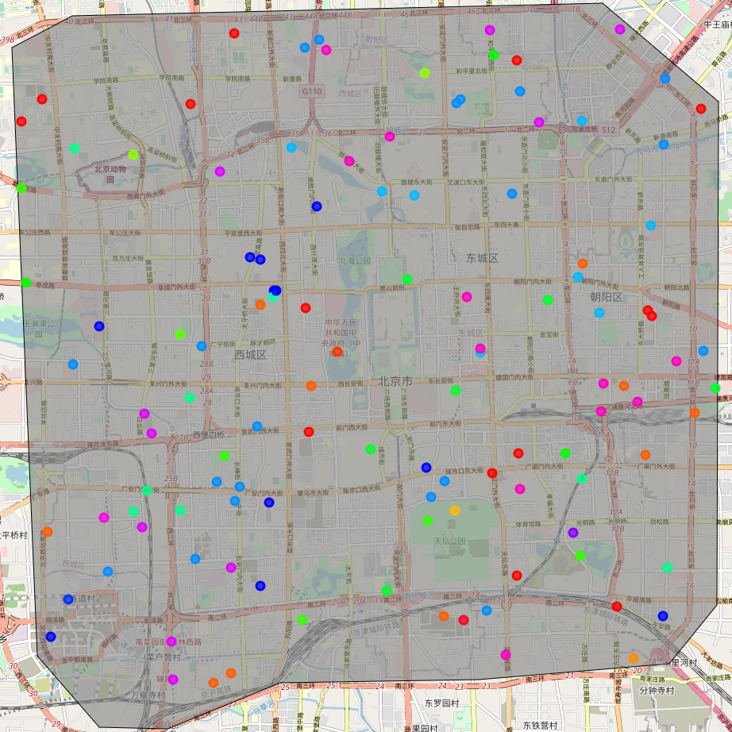
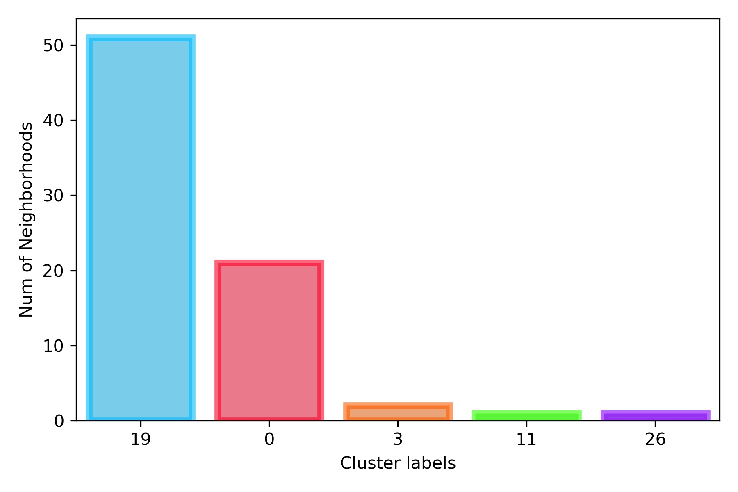
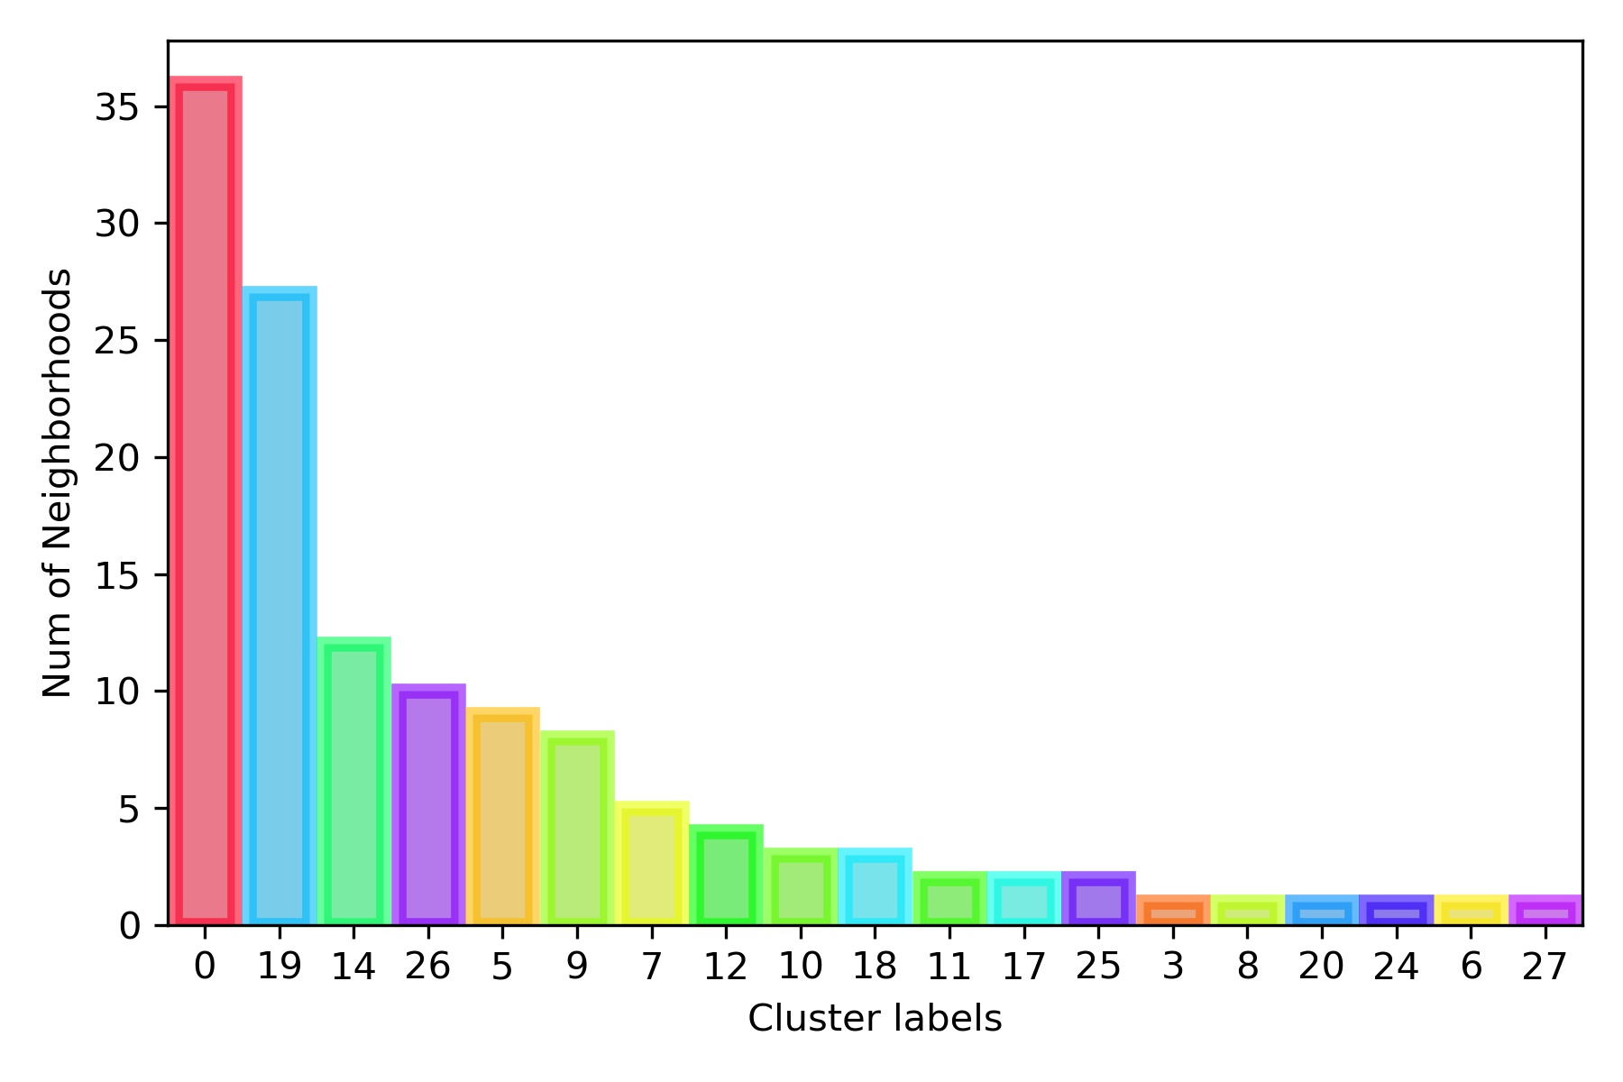
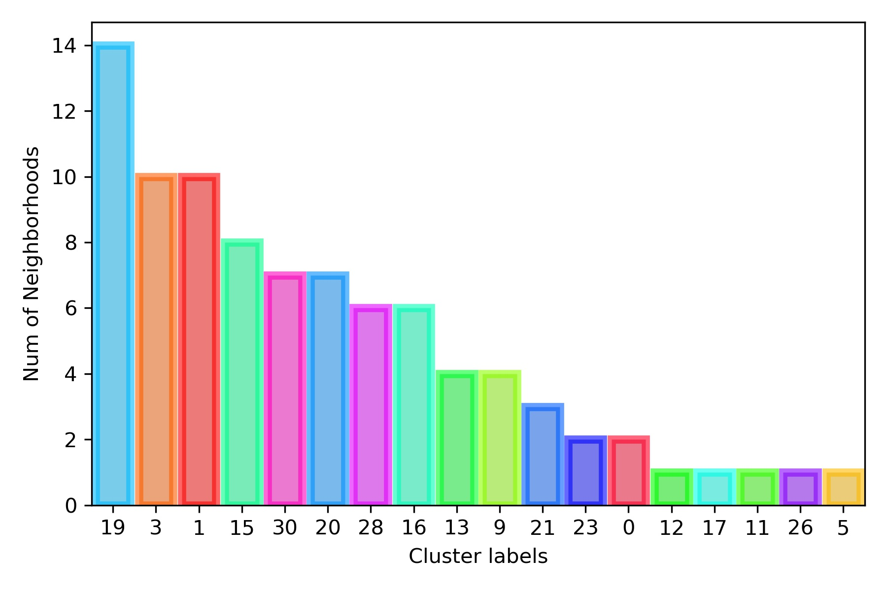
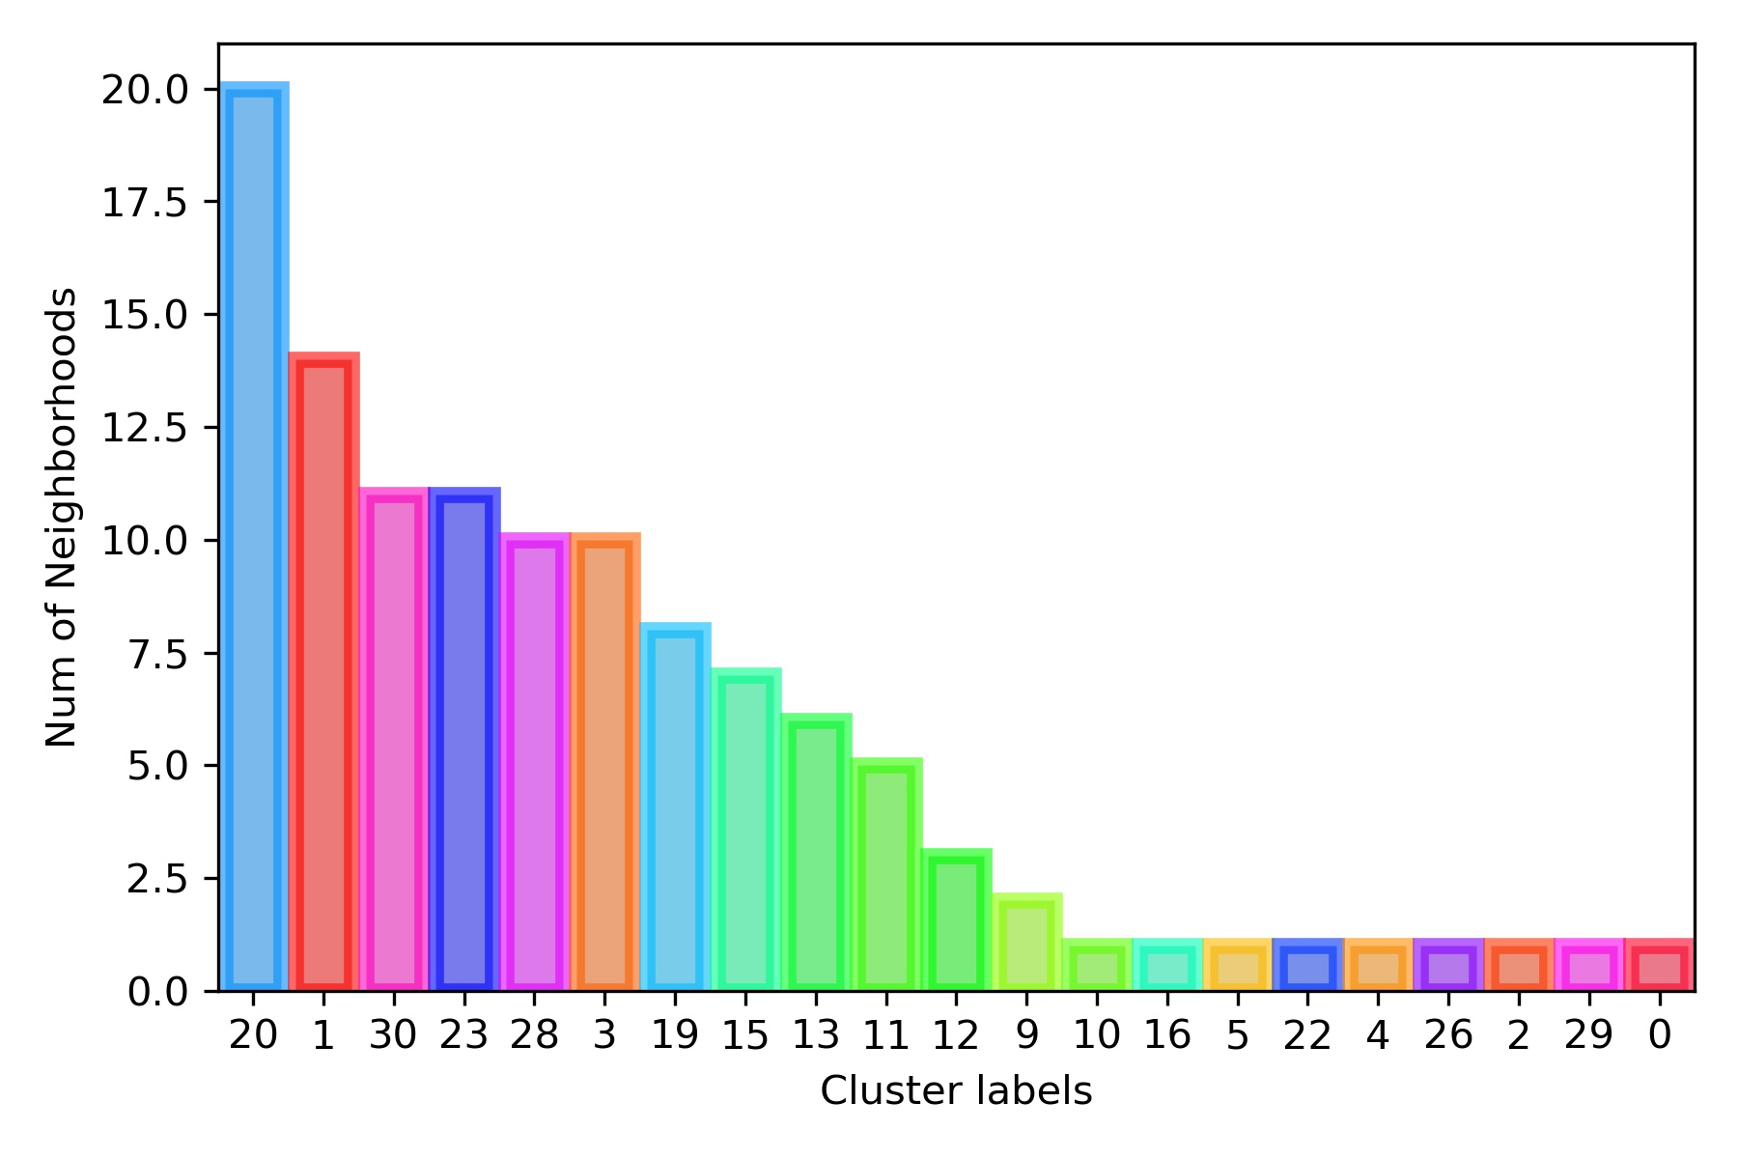
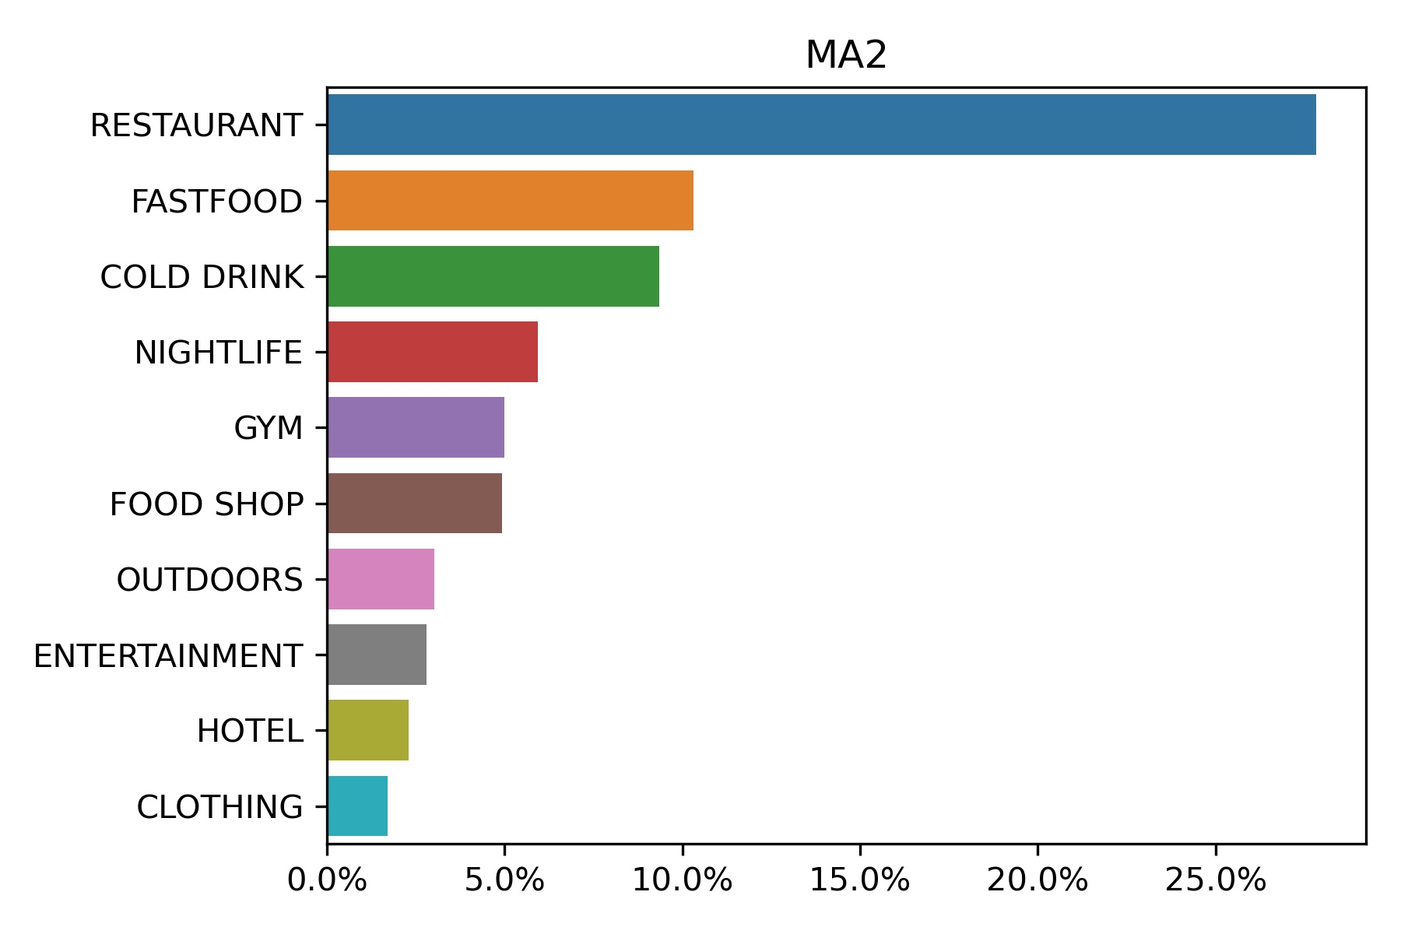
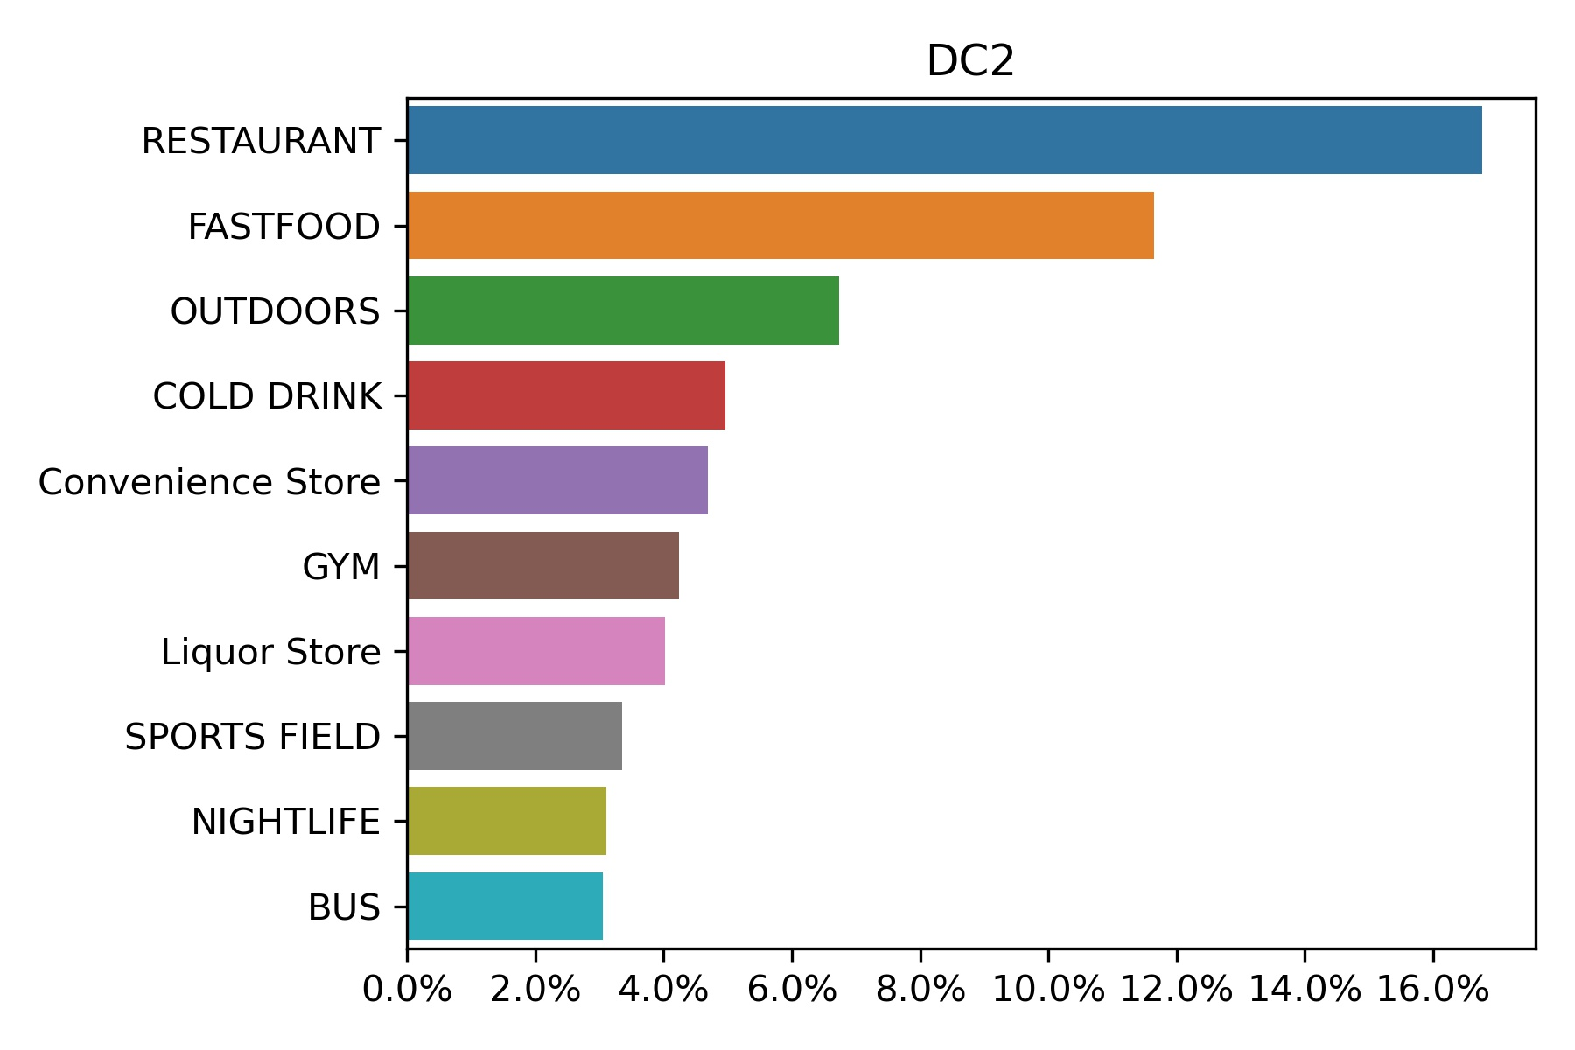
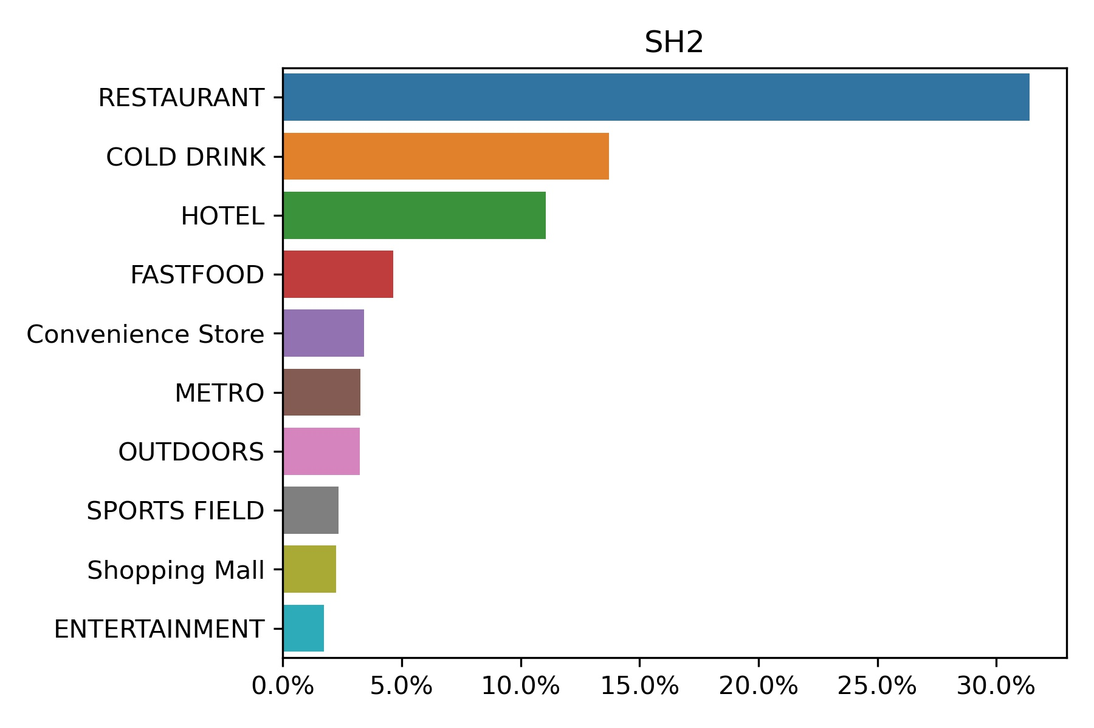
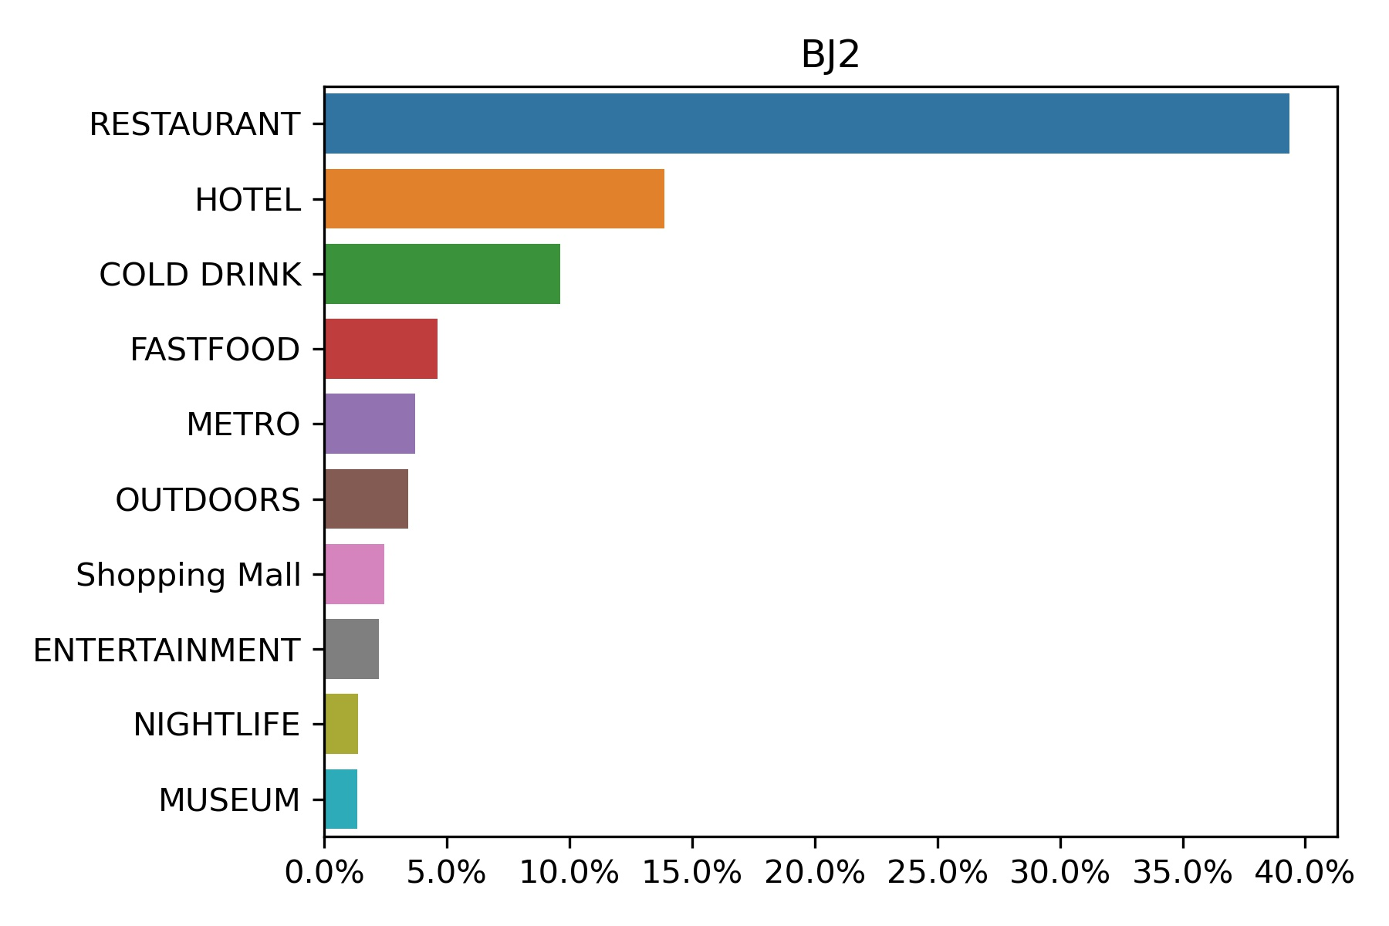
Result & Discussion
Clusters aggregate in American cities
Restaurant, fast-food, cold drink and ou-tdoors venues are highly need in all cities
Gyms and nightlife venues are more popular in American cities, though Beijing also has a less fraction of nightlife venues.
Hotel, metro and shopping malls are more needed in Chinese cities
A unique feature of Washington DC is the abundant liquor venues.
9

Slide 10
Conclusion
We generated cities features through classification of neighborhoods according to their venue categories.
The spatial distribution of neighborhoods in same cluster shows aggregation pattern in American cites, while in China, the neighborhoods are more randomly distributed.
Restaurant is the 1st needed venue categories in all cities. But in American cities, the American and Italian food are favored, in China, the Chinese food are popular.
Gym, nightlife venues are more abundant in American cities. In China, shopping mall, metro stations and hotels are much more.
Coffee shops are popular in most cities, while Washington DC, spatially in suburban region, has a high requirement of liquor shops.
From all these observations, we think culture > functions; i.e., though the city functions of DC and Beijing, as well as Manhattan and Shanghai are similar, the distinct culture between China and American leads to more difference among their cities.
10

